Slide 2
A market segmentation approach to improving linkage among young South African men
Shawn Malone
Population Services International (PSI)
Satellite session on “Sticky Linkage”: Latest evidence and strategies
21 July 2019

Slide 3
Study design and methods
Objectives
- To understand drivers and barriers for young men’s testing and linkage decisions and behaviors
- To identify different segments of young men to enable better tailoring/targeting
Geographic focus
5 districts of KwaZulu-Natal and 3 districts of Mpumalanga, South Africa
Qualitative phase
(n=76 men aged 25-34, 68 healthcare providers)
Non-random sample to achieve mix of HIV-positive (linked and not linked) and HIV-negative/unknown
Eight-hour filmed ethnographic shadowing (18 men, 4 HCPs)
Two-hour in-depth interviews (58 men, 64 HCPs)
Quantitative phase
(n=2019 men aged 20-34)
Random sample based on Enumerated Area sampling
One-hour tablet-based survey

Slide 4
Qualitative interviews revealed a range of barriers
Cost and convenience are part of the story, but only part
Innovations like extended hours and external pick-up points are highly positive
Will still be insufficient to get and keep some men on treatment
Barriers can also be personal and social, not just structural
Internalized motivation and awareness of relevant benefits
Social support
Provider empathy

Slide 5
The starting point: An outward appearance of apathy or indifference often masks fear
When we misread men’s emotional state, we can overlook or even reinforce fears that make linkage and retention more difficult
When I first heard of HIV it was the scariest disease that anyone can think of, it was even scarier than cancer. - Man, 25, frequent tester
I was terrified. I was not ashamed or embarrassed, I was just terrified.
- Man, 28, infrequent tester
“I don't trust myself. I'm so scared. I think I will test positive. It will just kill me. - Man, 30, never tested
[Testing] was tough, really tough. I actually felt like I was in a dark forest. I was numb with fear, I can’t lie to you. Until the sister said that I am negative, that is when I was free. - Man, 28, frequent tester

Slide 6
Loss of a sense of control and personal autonomy can feel threatening
Our intent is to ‘reach’ men, but some can experience it as being ‘chased’ or ‘hunted’
Tracking men down and dragging them into the system is at best a short-term solution
A testing and linkage process that ensures privacy and confidentiality and leaves men feeling a greater sense of control may contribute to more stable linkage
They are so difficult, especially the ones that are referred… They come here and tell you "I am not here for an HIV test.“ …Some are positive then they default because they say they were not at the clinic for that.
- Nurse
I don’t like the fact that when I go in for a headache the nurse will ask me when I last tested for HIV and now I will be compelled to test even though that’s not what I came in for. - Man, 30, infrequent tester
I walked to the [VMMC] center in a great mood, not even thinking I'll be tested when I'm there. When I got there, they said I must be tested, my mood changed. I wanted to turn back, but I was already there!…When she told me I was positive I was shattered into pieces. - Man, 27, HIV+, not linked
Notes:
Men who did not actively choose to test may feel ambushed by provider-initiated testing and go into denial rather than accepting their diagnosis.
Same-day initiation can leave some men feeling that a fundamental decision about their life and health has been taken out of their hands.
We may succeed in finding men and bringing them into the system, but we may not keep them if they feel it was against their will.

Slide 7
Being positive can feel like life is over, figuratively or even literally
Some men still associate HIV with sickness and death.
Many men associate HIV with losing identity, status, relationship and pleasure.
Many men need individualized counseling and support in coping with anticipated loss and reframing their lives after an HIV diagnosis
When I think of HIV I think of an early grave. After that, my mind comes back to the fact that there are pills for this illness, but that comes as an afterthought. - Man, 30, frequent tester
They say that once you get the news that you are positive, you die quickly.
- Man, 27, never tested
Men are scared to know their status, they assume that if they are positive, they no longer have a future and people won't respect them in the community. - Man, 27, HIV+, not linked
I would be worried if they tell me that I am indeed positive, then it will be game over.
I will no longer be Thabo.
- Man, 30, never tested *name changed
Notes:
Loss includes relationship conflict or loss, social death among friends/community, giving up pleasures like sex, alcohol, traditional medicine
Individualized support includes things like disclosure support and assisted partner notification

Slide 8
Awareness of the benefits of treatment is low
U=U/treatment as prevention is virtually unknown
“A longer and healthier life” often feels too vague and distant to be compelling
We tell men to start and stay on treatment if positive, but we don’t always explain why—in terms that are positive, relatable and compelling
We will only achieve stable retention when we have helped them to internalize a motivation to start and remain on treatment
I went home and I was overthinking it. But then I thought, ‘I'm okay, I'm healthy and everything is normal.’ So I just kept it all to myself. - Man, 27, HIV+, not linked
Why? I'm not sick. My body shape has not changed, I am not losing or gaining weight.
- Man, 25, HIV+, not linked

Slide 9
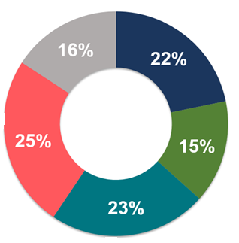
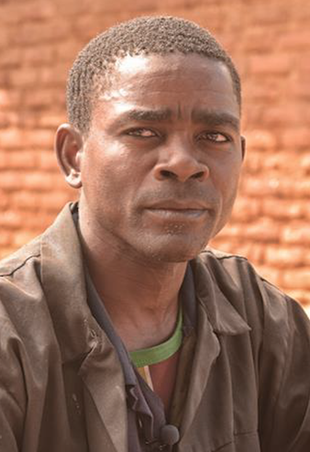
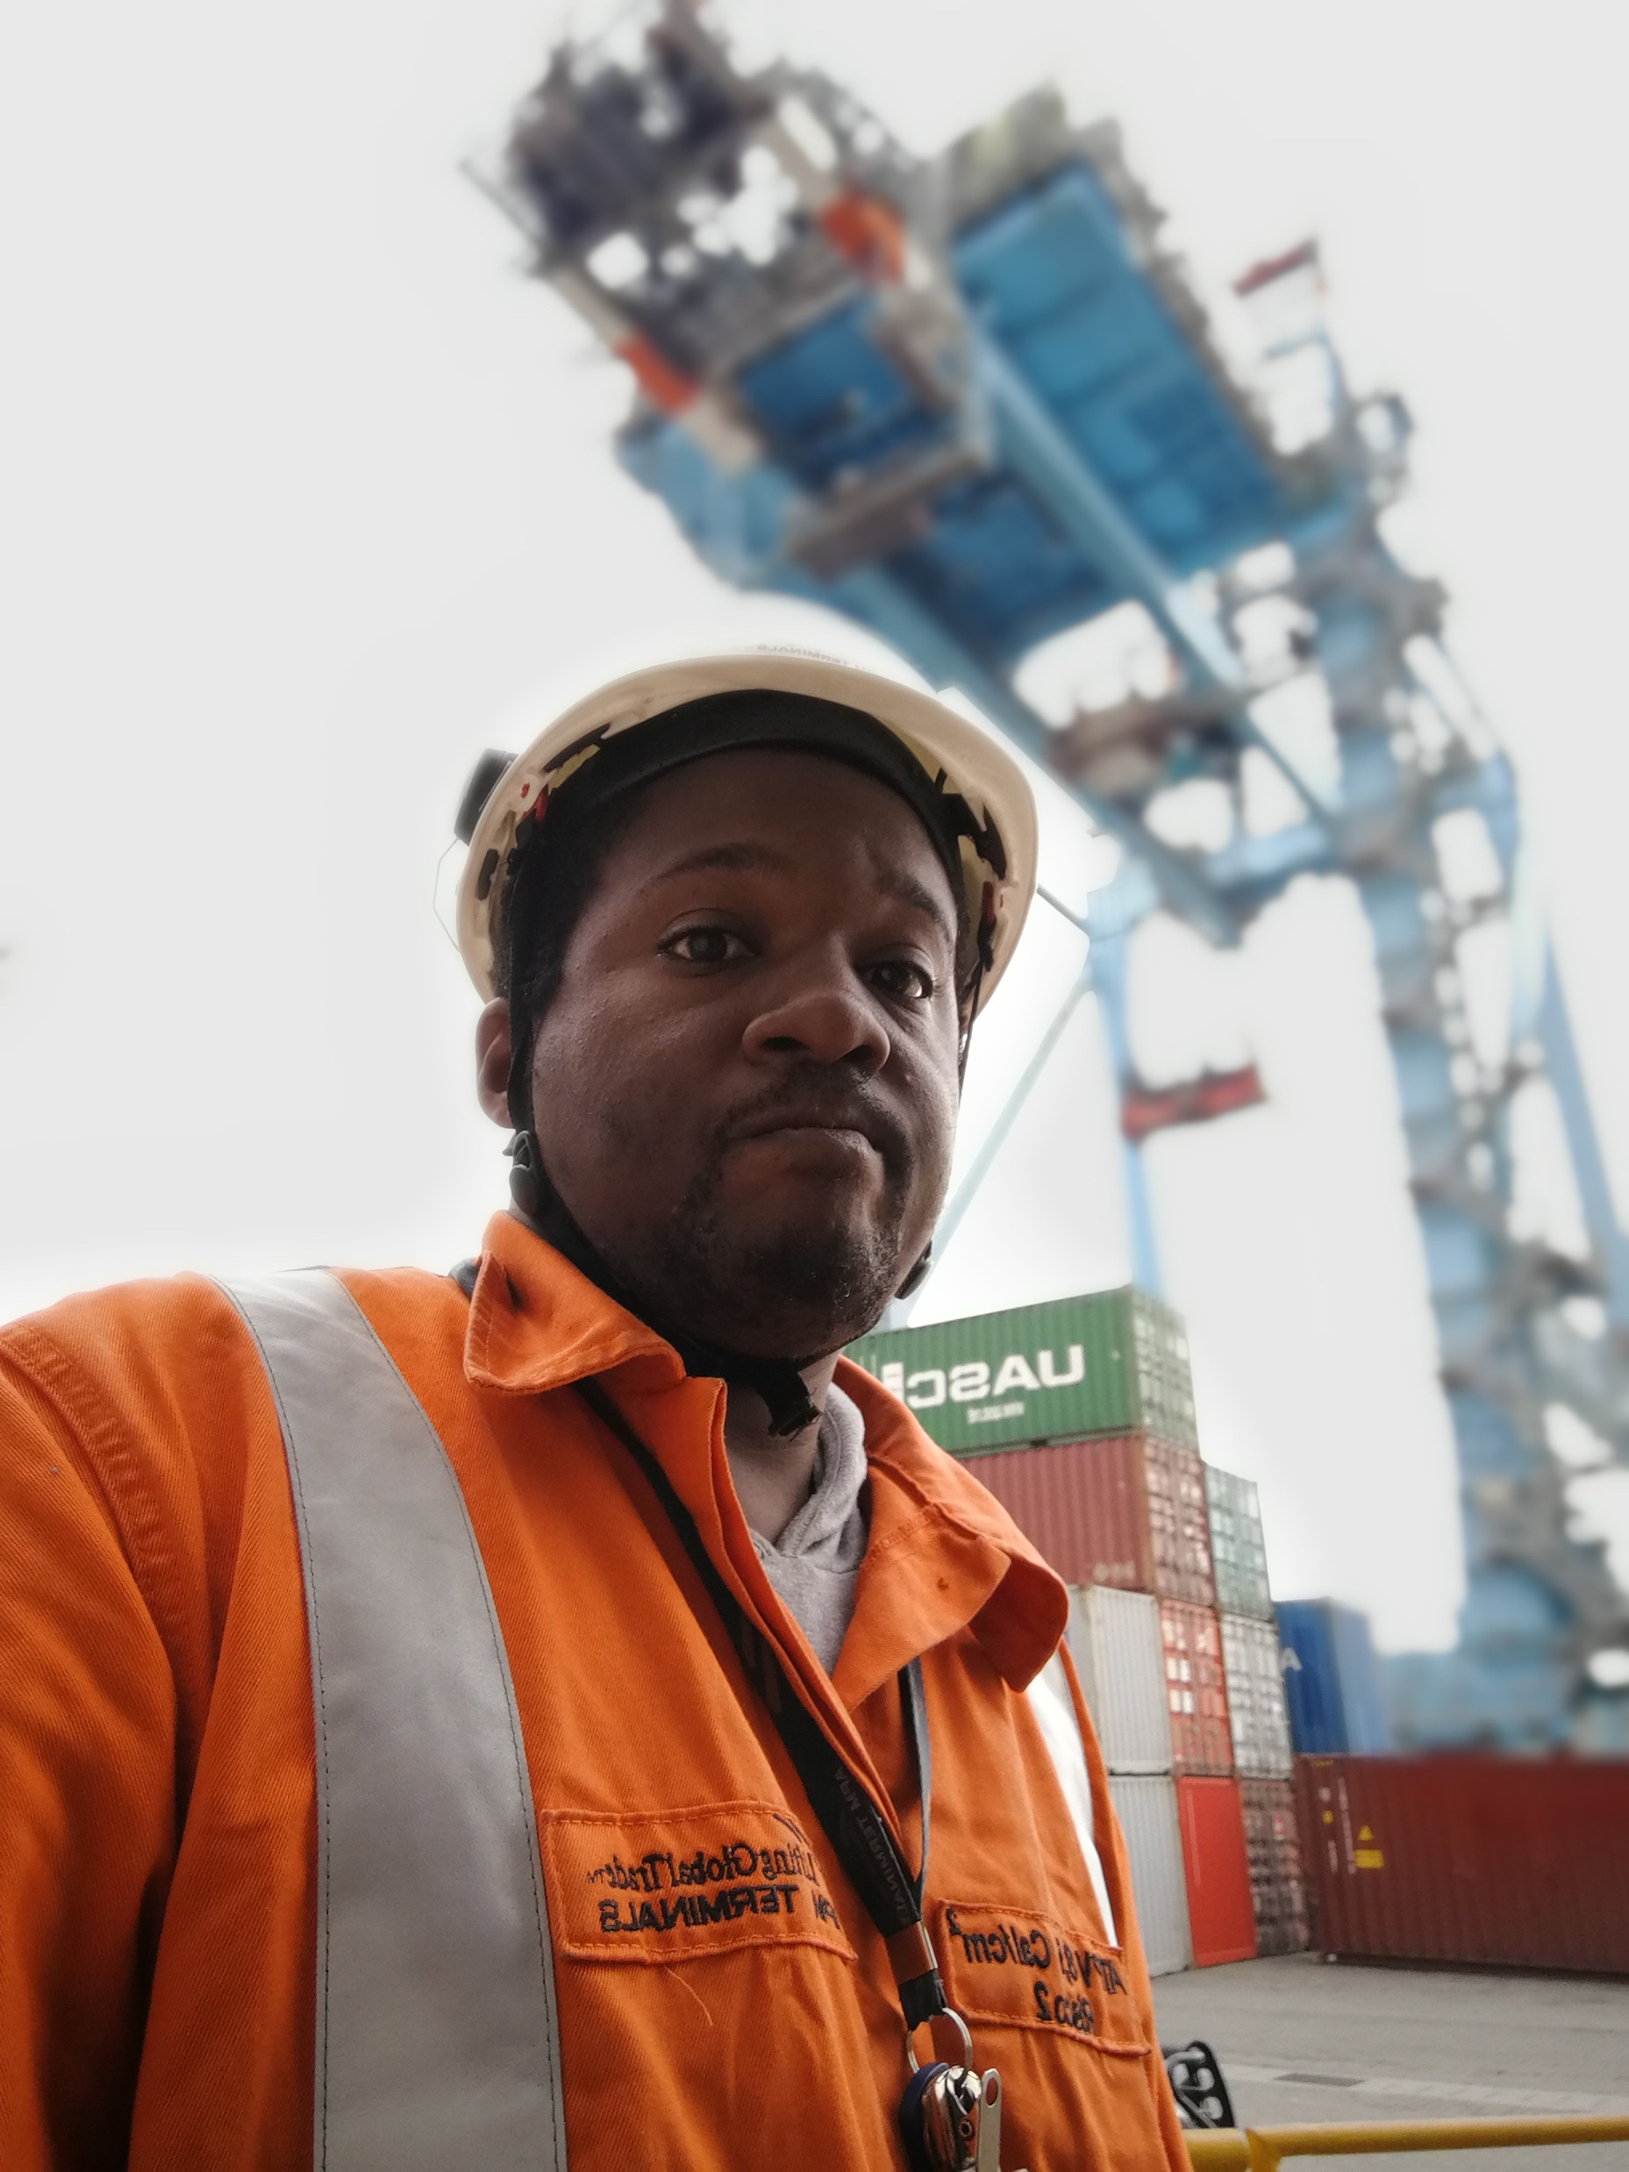
The quantitative research enabled identification of five distinct segments based on HIV-relevant knowledge, attitudes and behaviors
Mr Grey
Mr Blue
Mr Rose
Mr Teal
Mr Green

Slide 10
Mr. Rose
30% never initiated treatment on testing positive
What’s keeping him from linking?
Fears starting ART would mean ‘the end of the party’
Fears disclosure would jeopardize his primary relationship
What might help?
Counseling that focuses on continuing to live a fun and carefree life, rather than what he must give up
Support in disclosing to his partner and friends
Messages on U=U/Treatment as Prevention
Young, fun-loving, and optimistic about his future, with a high level of HIV knowledge but also a higher number of sexual partners

Slide 11
Mr Teal
18% never initiated treatment on testing positive
What’s keeping him from linking?
Fears having HIV would diminish his reputation, turning him from ‘the good guy’ into ‘the bad guy’
Fears having HIV would jeopardize his primary relationship
What might help?
Counseling to help him reframe and retain his identity as an upstanding member of the community
Support in disclosing to his family and community
Messages that reduce stigma around PLHIV as irresponsible, promiscuous, ‘a problem’
Young, responsible, engaged in his community, optimistic about the future, and open about sexual health and health-seeking
| Breaking the cycle of transmission |

Slide 12
Mr Green
30% never initiated treatment on testing positive
What’s keeping him from linking?
Fears having HIV would drag him down even further in life
Very low knowledge of HIV and ART
Few people he trusts or feels comfortable talking to
Negative view of healthcare system and providers
What might help?
Empathetic counseling that helps him to surface and cope with his extensive issues and barriers
Peer outreach that makes services and support relatable
Services that make it easy to be on treatment
Adherence clubs and other social/group approaches
Information on the benefits of treatment
Disconnected and pessimistic, with a low level of education, very low HIV knowledge, more indicators of depression, problematic use of alcohol, a traditional concept of gender, higher rates of intimate partner violence
| Breaking the cycle of transmission |
Notes:
Services that make it easy to be on treatment—taking services to him and making them a relief not a burden
Adherence clubs and other social/group approaches—he likes ‘safety in numbers’ and tends to go with the flow
Information on the benefits of starting treatment—he has very low overall knowledge of HIV

Slide 13
Mr Blue
25% never initiated treatment on testing positive
What’s keeping him from linking?
Fears that having HIV would be yet another burden to carry.
Few meaningful connections or sources of motivation
Few people he trusts or feels comfortable talking to
Negative view of the healthcare system and providers
What might help?
Empathetic counseling that helps him to identify and leverage sources of motivation
Services that make it easy to be on treatment
Information on the benefits of treatment
More educated and more stable, but with a bleak outlook on life, few meaningful connections or sources of motivation, and problematic alcohol use linked to impulsive behavior
| Breaking the cycle of transmission | 14

Slide 14
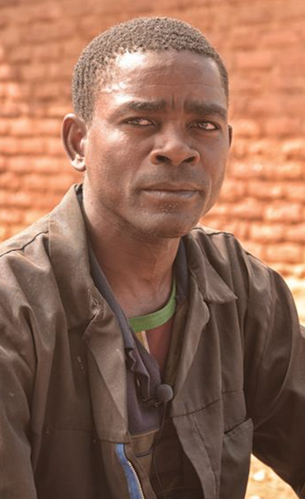
Mr Grey
14% never initiated treatment on testing positive
What’s keeping him from linking?
He’s actually not doing too bad—his greater barrier is testing
Fears having HIV would diminish his standing in the community
Few people he trusts or feels comfortable talking to
What might help?
Counseling that helps him cope with his fear of losing his identity as a traditional family and community man
Support in disclosing to his partner, family and community
Messages on U=U/Treatment as Prevention
A traditional, community-oriented, often rural man, with a low level of education, low HIV knowledge, high level of fear of HIV, but a positive outlook and a sense of responsibility to family and community
Notes:
Note: Challenge for this segment appears to be more testing than linkage

Slide 15
Conclusions
Making linkage easier is important…
Across segments, barriers related to time, cost and convenience can be the primary impediment to linkage.
Those barriers can also camouflage root causes, making them harder to surface and address.
…but for some segments of men it will not be sufficient
We can follow up with men who test positive, and we can even put services right in front of them in the community, but we are unlikely to achieve sticky linkage if treatment remains passive and externally driven.
We also need to pay attention to other factors
Internalizing motivation
Retaining or reframing identity and lifestyle
Reducing stigma and increasing social support
Increasing provider empathy
What works on each of these points will be different for different segments
We therefore need tools and approaches that allow us to understand each individual and to surface and address their particular barriers and challenges.
Notes:
Internalizing motivation. We need to help men understand why they should be on treatment, in terms they find compelling and relatable.
Retaining or reframing identity. For some men, having HIV means I can no longer be who I am. Individualized counseling and support can help to dispel this fear or at least build coping ability.
Social support. Many men fear that treatment will mean tension, conflict or loss in key relationships. They need support in managing disclosure as well as a more supportive social environment (stigma reduction).
Provider empathy. We need to help men feel welcomed, understood, respected and cared for by providers.

Slide 16
Acknowledgements

Slide 17
Thank you!
Contact:
Shawn Malone
Project Director
+27 81 038 1862
smalone@psi.org

